Slide 1
Data Modelling, Management & Governance CIS108-6 Data Security, Governance, and Ethical Issues
Dr Gangmin Li

Slide 2
Agenda
Data Security
Data Governance
Ethical issues
Best practice

Slide 3
1. Data Security

Slide 4
Needs
The DBMS is to store, manage and facilitate access to data.
DBMS is deployed on the Internet (web servers) which is a distributed environment
Large databases are usually shared with many users
All the database are accessed by multiple users in the same time (concurrent access)
Database use may have:
User errors
Malicious attack
Confidentiality breach (careless mistakes)

Slide 5
Security vs Integrity
Integrity: Ensuring what users are trying to do is correct
Security: Ensuring users are allowed to do things they are trying to do
Both working together to ensure the secure of data stored in a database.

Slide 6
Security Measures
Ensure data integrity
Integrity constraints: Entity integrity, referential integrity
Backup: the process of periodically taking a copy of the database + log-files onto offline sources
Full, incremental and concurrent backup
Journaling: maintaining a log-file of all changes made to enable recovery in the event of failure
Check-pointing: synchronising database and log-file update at a specified time – point of reference
Recovery and restored: in case of problem restore to the last normal state
Ensure security：
Authentication：users are who they say they are (e.g., login and password)
Authorisation： Granting a right or privilege to users to legitimately access data
Access control：allow authorised person access the relevant data.

Slide 7
Types of Integrity and Constraints
Domain/Type Constraints: Specify legal values for types/domains
Attribute Constraints: Specify legal values for attributes
Entity Integrity: Rules governing single relations (e.g., Primary keys must be unique and Non-NULL)
Referential Integrity: There must not be any unmatched foreign key values
SQL provides ways of defining these rules or constraints.

Slide 8
SQL: Domain/Type Constraints
Domain: Data type with optional constraints
The newly created domain can be used in a CREATE TABLE statement
CREATE DOMAIN domain_name [AS] data_type
[DEFAULT default_option]
[CHECK (search_condition)]
CREATE DOMAIN gender_type AS CHAR
CHECK (VALUE IN (‘M’, ‘F’))
CREATE TABLE Person (name VARCHAR2(32),
gender gender_type);

Slide 9
SQL: Attribute Constraints
Legal values for attributes are determined by its domain
CREATE TABLE fruit(
name char(30),
supplier char(20),
country char(20));
Name is char(30), supplier and country are char(20)
Character type with length 30 and 20

Slide 10
SQL: Entity Integrity
Entity integrity enforced by naming PRIMARY KEY (i.e., attribute or set of attributes that should be NOT NULL and UNIQUE). Example:
CREATE TABLE staff(
staffNo number(3),
name char(30),
PRIMARY KEY (staffNo));

Slide 11
Entity Integrity (cont’d)
For alternate keys we can use NOT NULL and UNIQUE qualifiers after column attribute name. E.g.:
CREATE TABLE fruit(
name char(30) PRIMARY KEY,
supplier char(20) NOT NULL,
country char(20) NOT NULL,
UNIQUE (supplier, country));

Slide 12
SQL: Referential Integrity
Defined by FOREIGN KEY or REFERENCES.
Referential action must allow cascading of updates from parent to child table (+deletes, NULL value , DEFAULT). E.g.:
CREATE TABLE emps(
emp# number(2),
name char(30),
dept# number(2) REFERENCES depts(dept#)
ON UPDATE CASCADE);
Notes:
Referential integrity is defined by FOREIGN KEY or REFERENCES qualifiers in table definition. Referential action must allow cascading of updates (not just deletes, or NULL value and DEFAULT actions) from parent to child table. E.g.:
CREATE TABLE emps(
emp# number(2),
name char(30),
dept# number(2) REFERENCES dept
ON UPDATE CASCADE);
Triggers are procedural elements and not a substitute for referential action. Triggers should only be used if the referential action is complicated – e.g., if a non-relational update of an attribute is necessary on access to tables outside definition.
A database trigger is procedural code that is automatically executed in response to certain events on a particular table or view in a database. The trigger is mostly used for keeping the integrity of the information on the database. For example, when a new record (representing a new worker) is added to the employees table, new records should be created also in the tables of the taxes, vacations, and salaries.Whenever rows in the master (referenced) table are deleted (resp. updated), the respective rows of the child (referencing) table with a matching foreign key column will get deleted (resp. updated) as well. This is called a cascade delete (resp. update[2]).
Example Tables: Customer(customer_id, cname, caddress) and Order(customer_id, products, payment)
Customer is the master table and Order is the child table, where 'customer_id' is the foreign key in Order and represents the customer who placed the order. When a row of Customer is deleted, any Order row matching the deleted Customer's customer_id will also be deleted.

Slide 13
Recovery
Restoring a database to a known correct state after some failure.
Database recovery is based on redundancy at the physical level
Any piece of information can be recovered from some other stored information, somewhere else
Recovery is done by Transactions (a logical unit of work that consists of a series of commands) that can either result as Commit (successful) or Rollback (if any command is fail)
Notes:
Redundancy on the logical level – we tried to get rid of this through normalisation!

Slide 14
Example: Transfer Funds
BEGIN TRANSACTION;
UPDATE ACC123 {BALANCE := BALANCE - £100};
IF any error occurred THEN GOTO UNDO; END IF;
UPDATE ACC456 {BALANCE := BALANCE + £100};
IF any error occurred THEN GOTO UNDO; END IF;
COMMIT;
GOTO FINISH; /*successful end*/
UNDO:
ROLLBACK; /*unsuccessful end*/
FINISH:
RETURN;
Notes:
How to UNDO an update: System maintains a log or journal of each update
No nested transactions!

Slide 15
Two Database Security Approaches
Discretionary Control
Named users, access restricted based on identity of user or group
Different Privileges or access rights to data objects
Distributed control (no central management)
Allows users the ability to make policy decisions and/or assign security attributes
Users may pass the permission to others
Mandatory Control
Users have clearance
Objects have classification levels
Central control – predefined access rights depending on clearance level
Notes:
In computer security, discretionary access control (DAC) is a kind of access control defined by the Trusted Computer System Evaluation Criteria^{[1]} "as a means of restricting access to objects based on the identity of subjects and/or groups to which they belong. The controls are discretionary in the sense that a subject with a certain access permission is capable of passing that permission (perhaps indirectly) on to any other subject (unless restrained by mandatory access control)".
Discretionary access control is commonly defined in opposition to mandatory access control (sometimes termed non-discretionary access control). Occasionally a system as a whole is said to have "discretionary" or "purely discretionary" access control as a way of saying that the system lacks mandatory access control. On the other hand, systems can be said to implement both MAC and DAC simultaneously, where DAC refers to one category of access controls that subjects can transfer among each other, and MAC refers to a second category of access controls that imposes constraints upon the first.
A database management system, in its access control mechanism, can also apply mandatory access control. In this case, the objects are tables, views, procedures, etc.
With mandatory access control, this security policy is centrally controlled by a security policy administrator; users do not have the ability to override the policy and, for example, grant access to files that would otherwise be restricted. By contrast, discretionary access control (DAC), which also governs the ability of subjects to access objects, allows users the ability to make policy decisions and/or assign security attributes.

Slide 16
Discretionary Control: GRANT
GRANT [privilege-commalist | ALL PRIVILEGES]
ON object-name
TO [authorisation_id_list | PUBLIC]
[WITH GRANT OPTION]
SQL Grant. Each privilege is one of the following:
SELECT
DELETE
INSERT
UPDATE
REFERENCES
The REFERENCES allows privileges to be granted on named
table(s) in integrity constraints of CREATE TABLE
The GRANT OPTION allows the named users to pass the
privileges on to other users (distributed control)
Notes:
In the 1990s and 2000s many additional kinds of privileges arrived in standard SQL, in association with support for user-defined operators and user-defined types, for example. They are all beyond the scope and the ones we teach here are as in the SQL of 1979.

Slide 17
Discretionary Control: REVOKE
If a user A grants privileges to user B, then they can also revoke
them e.g.
REVOKE ALL PRIVILEGES ON STATS FROM John;
SQL REVOKE syntax
REVOKE [GRANT OPTION FOR]
[privilege_list | ALL PRIVILEGES]
ON object_name
FROM [authorisation_list|PUBLIC]
[RESTRICT|CASCADE]
If RESTRICT option is given then the command is not executed
if any dependent rules exist i.e. those created by other users
through the WITH GRANT OPTION.
CASCADE will force a REVOKE on any dependent rules.

Slide 18
Mandatory Control Pricinples
User i can retrieve object j only if the clearance level of i is greater than or equal to the classification level of j (“simple security property”)
User i can update object j only if the clearance level of i is equal to the classification level of j (“star property”)
Notes:
Rule 2 requires that the classification level is equal. This would for instance prevent people with “secret” classification from copying secret data to a file of lower classification, i.e. the classification level of a file cannot be changed!

Slide 19
2. Data Governance

Slide 20

DBMS cannot guarantee…
We already have DBMS which is managing data for aggregation, storage and retrieval and use (access) , BUT …
Is data being fully managed in an organisation?
Is the value of data being realised?

Slide 21

Risks
With DBMS ONLY and without data governance, organisation will never fully realize the potential of data and in fact may subject to increasing level of risk over time:
Bad data (poor data quality)
Privacy challenges
Regulation and compliance
Week cyber security
Customers’ trust

Slide 22
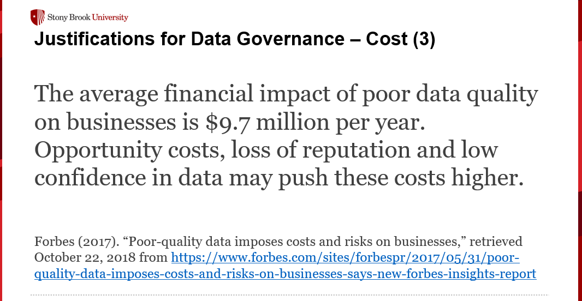
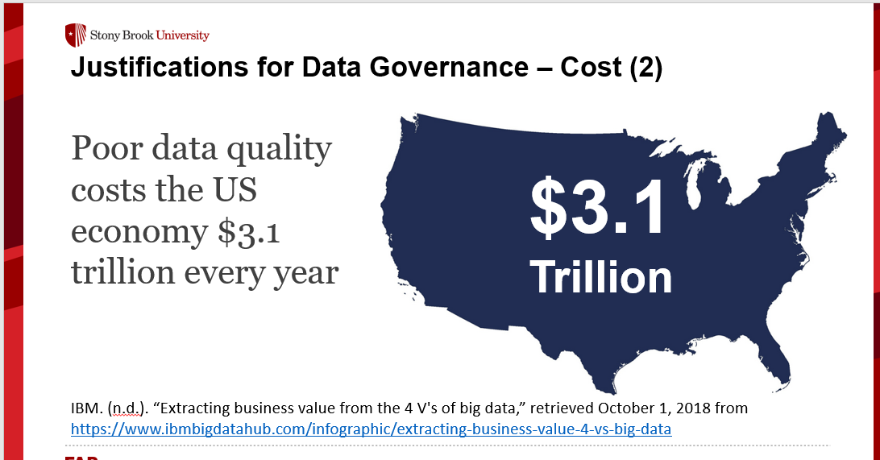
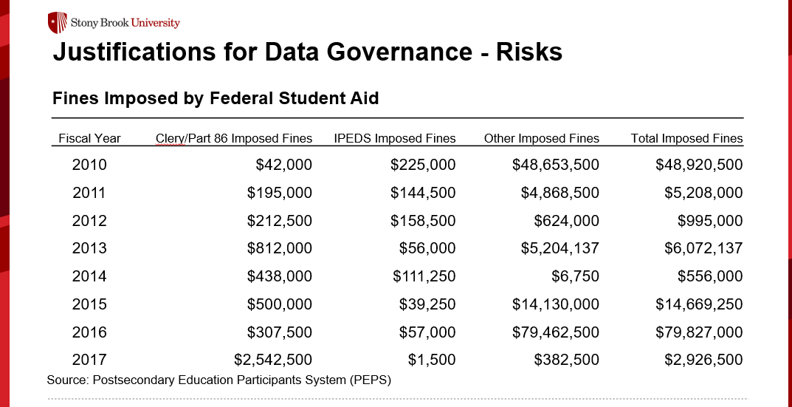
Cost examples
These can be avoid by technology ONLY !

Slide 23
Questions remained unanswered
Primary questions (DBMS does not provide answers)
Data Ownership: Who owns data?
What are the right of the data owner?
How to protect privacy and data sharing?
How to ensure the data security and efficient access?
Who controls the Internet and Database (Data storage)?
What elements will be controlled and how?

Slide 24
Benefits
Mature data management and proper data governance will:
Improved monitoring and tracking mechanisms for Data Quality
Greater transparency within any data-related activities
Better resolution of past and current data issues
Increase in value of an organization’s data
More accurate procedures around regulation and compliance activities
Help with instituting better training and educational practices around the management of data assets
Ability to provide standardized data systems, data policies, data procedures, and data standards
Lower costs associated with other areas of Data Management
Overall enterprise revenue growth

Slide 25
What Is Data Governance?
There are many different versions of definitions:
“The exercise of authority and control (planning, monitoring, and enforcement) over the management of data assets.” (DAMA International)
“A system of decision rights and accountabilities for information-related processes, executed according to agreed-upon models which describe who can take what actions with what information, and when, under what circumstances, using what methods.” (Data Governance Institute)
“The specification of decision rights and accountability framework to ensure the appropriate behavior in the valuation, creation, consumption, and control of data and analytics.” (Gartner Glossary)

Slide 26
What Is Data Governance?
Data Governance is a collection of components: data, roles, processes, communications, metrics, and tools that help organizations formally manage and gain better control over data assets.
As a result, organizations can best balance the availability, usability, integrity, and security of their data.
Be compliant with standards and regulations
Drive enormous business value and support digital transformation

Slide 27
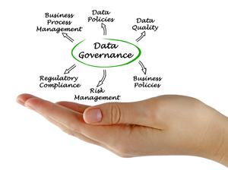
What Is Data Governance?
The 5-second elevator definition Data Governance:
A set of guidelines for how people behave and make decisions about data

Slide 28
Data Governance Components
Documents
Charter framework
Written & published policies
Groups
Policy council
Data steward council(s)
Individual roles
Data stewards
Data custodians/ caretakers
Data users
Principles & values
Purpose & scope
Roles & responsibilities
Data dictionaries
Communication strategies
Information security council/program
Senior leadership [buy-in]
Positions/office to support DG

Slide 29
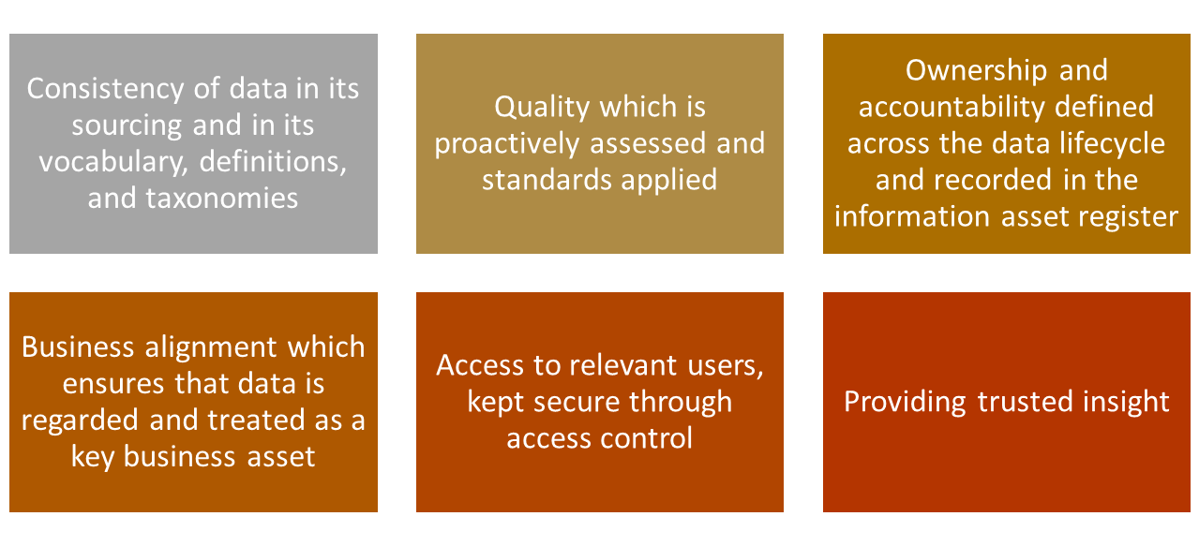
Principles of Data Governance (Generic)
Source: Carruthers, C. & Jackson, P. (2018). The chief data officer’s playbook, London: Facet, p. 145

Slide 30
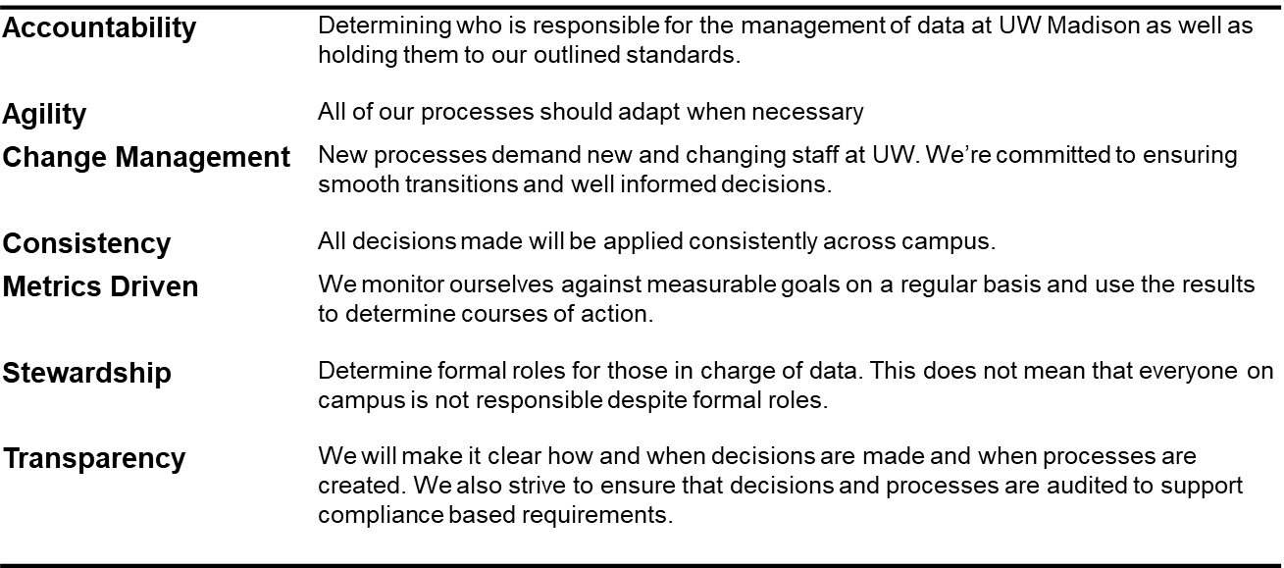
Principles and Values – Example 1
University of Wisconsin - Madison
Source: https://data.wisc.edu/data-governance/#principles

Slide 31
Principles and Values – Example 2
Stony Brook University
Values
Shared Assets Data and information are shared organizational resources that constitute valuable assets. | Stewardship Employees of Stony Brook University have a responsibility for the curation of data. They serve as caretakers of data to ensure data are collected, stored, and maintained under the premise that others will access and use them over time |  |  | Quality To ensure data retain value, quality of data is actively monitored and maintained | Privacy & Confidentiality Maintenance of individual privacy and confidentiality of educational and personal records represent not only legal requirements but also primary outcomes of data management.
Principles for Data Governance
Organizational Effectiveness |  | Transparency | Communication |  | Compliance
Auditability |  | Integrity | Accountability |  | Standards
Source: https://www.stonybrook.edu/commcms/irpe/about/_files/DataGovFramework.pdf

Slide 32
Connect Data Governance to Mission
Data governance is a system to improve the effectiveness of the organization, not an activity for its own sake
Anchor data governance to mission when justifying need or presenting DG structure

Slide 33
Example
Stony Brook University’s framework for data governance outlines a set of principles, structures, roles, and responsibilities to improve the data infrastructure and to advance institutional goals
Stony Brook has a five-part mission to provide & carry-out:
Highest quality comprehensive education
Highest quality research and intellectual endeavors
Leadership for economic growth, technology, and culture
State-of-the-art innovative health care, with service to region and traditionally underserved
Diversity and positioning Stony Brook in global community

Slide 34
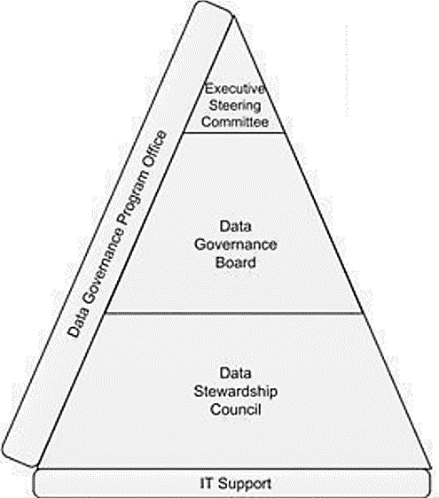
Structure of DG (generic)
Executive Steering Committee
Authorized to change the organization
Drives cultural change
Supports the program enterprise-wide
Provides funding for the Data Governance Program
Executive Steering Committee
Authorized to change the organization
Drives cultural change
Supports the program enterprise-wide
Provides funding for the Data Governance Program
Business Data Stewards
Experts on use of their data domain data
Able to reach out to SMEs to gather information and make decisions
Typically someone who others come to as the most knowledgeable about the meaning of the data (and how it is calculated)
Makes recommendations on data decisions and write data-related procedures
Plotkin (2014). Data stewardship: An actionable guide to effective data management

Slide 35
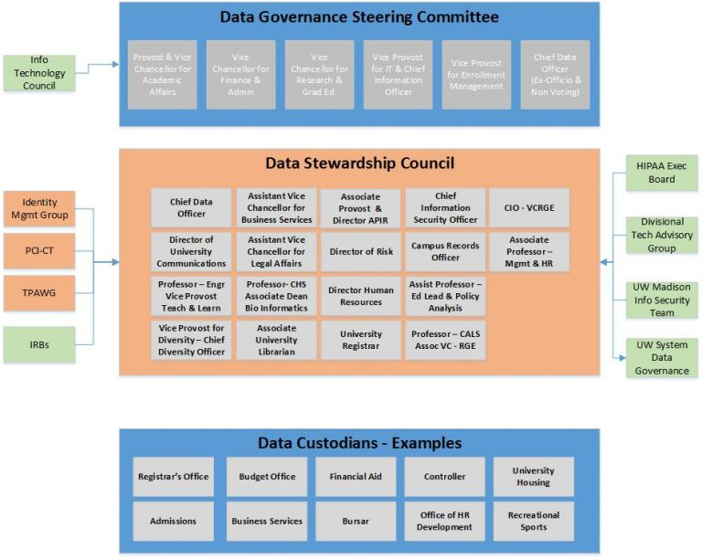
Structure Example 1
University of Wisconsin-Madison
Data Governance Steering Committee
provides executive level guidance to the program
promotes Data Governance across UW-Madison
allows for / facilitates data-driven decision making
determines priority and budget of major data-related projects.
Data Stewardship Council
determines operational structure of the program
drafts, communicates, and recommends approval of data-related policies
implements, budgets, and monitors data-related programs across UW-Madison.

Slide 36
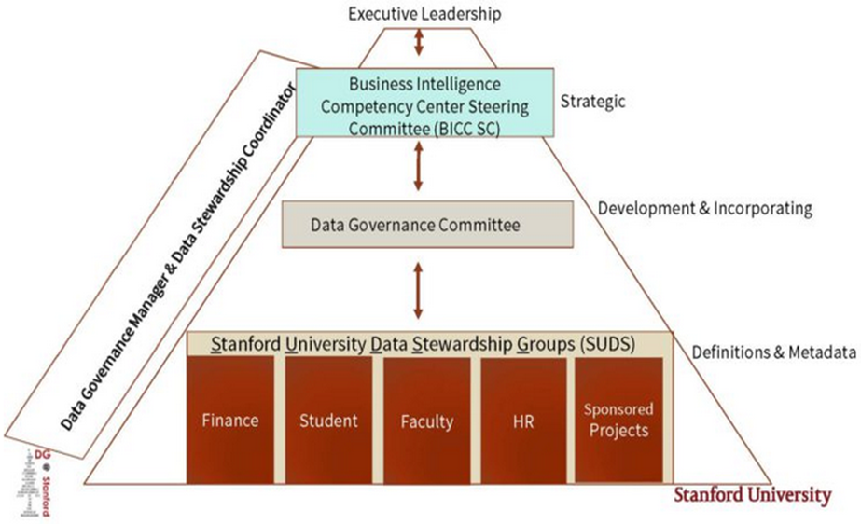
Structure Example 2
Stanford University
BI Competency Ctr. Steering Committee
Cross-functional oversight & communicates long-term value of BI program
Achieves peer buy-in, and effects change in business process and data quality
DG adopters and champions
Ensures alignment of DG with university goals
Data Governance Committee
Sets & incorporates DG policies, standards, procedures, roles & responsibilities
Includes lead steward from each of the data steward groups, plus reps from additional units
Data Stewardship Groups
Provide metadata infrastructure to support improved decision-making university-wide
Ensure information integrity
Build data knowledge
Meet compliance requirements
SMEs who define reporting terms and gather metadata associated with their reporting environment

Slide 37
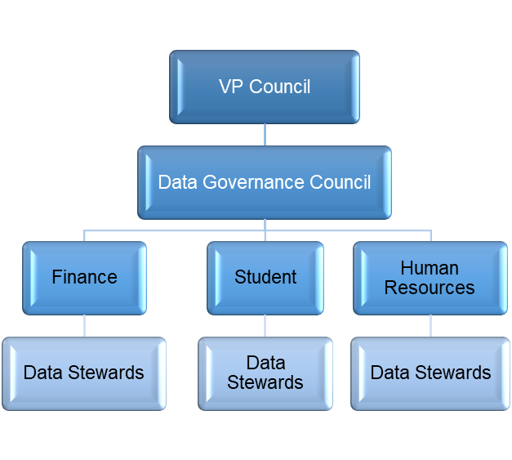
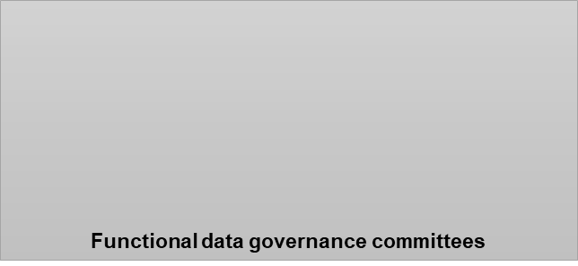
Structure Example 3
Stony Brook University
VP Council (Project 50 Forward SteerCo)
Executive sponsors of project
Establishes authority and purview of data governance system
Data Governance Council
Recommends and implements institutional policy for data governance
Sets priority for

Slide 38
Data Governance Council
The actual Policy-Making Body
Prioritizes decisions regarding data to address most relevant needs of organization
Reviews, evaluates, and reports on data governance performance and effectiveness
Ensures that annual performance measures align with data governance and business objectives
Reviews and approves data governance policies and goals
Ultimately is accountable for business data use, data quality, and prioritization of issues
Makes strategic and tactical decisions
Defines data strategy based on business strategy and requirements
Plotkin (2014). Data stewardship: An actionable guide to effective data management

Slide 39
Data Stewardship Definitions
Data stewardship is the most common label to describe accountability and responsibility for data and processes that ensure effective control and use of data assets. – Knight (2017)
Data stewardship is the operational aspect of an overall Data Governance program, where the actual day-to-day work of governing the enterprise’s data gets done. –Plotkin (2014)
Data Stewardship is concerned with taking care of data assets that do not belong to the stewards themselves. Data Stewards represent the concerns of others. Some may represent the needs of the entire organization. Others may be tasked with representing a smaller constituency: a business unit, department, or even a set of data themselves. – Data Governance Institute (n.d.)

Slide 40
Types of Data Stewards
Business Data Steward
Accountable for data owned by business area
Technical Data Steward
Provide expertise on applications, ETL, data stores, and other links in information chain
Work with stakeholders to make recommendations on data issues
Manage metadata for their data
Champion data stewardship for their areas
Assigned by IT leadership to support data governance
Domain Data Steward
Business steward for widely shared data
Work with business stewards as stakeholders to achieve consensus
Project Data Steward
Represent data stewardship on projects
Funded by projects
Work with business data stewards to obtain info and make recommendations about data stewarded by business stewards
Notify business data stewards about data issues raised by the project
Operational Data Steward
Provide support to business data stewards
Recommend changes to improve data quality
Help enforce business rules for the data they use

Slide 41
Data Steward Responsibilities
Oversee management of selected data assets
Participate in data governance and carry out decisions
Assist in creation and maintenance of data dictionaries, metadata
Document rules, standards, procedures, and changes
Ensure data quality and manage specific issues
Communicate appropriate use and changes
Manage access and security

Slide 42
Stony Brook Roles and Responsibilities Matrix
 | Data Governance Council | Functional Data Governance Cmtes | Data Stewards
Standards and Policies | Define, Establish, Monitors, Audit, Verify, Develop, Revise | Cross functional implementation, coordination | Functional implementation
Data Quality | Identify, Adopt enterprise-wide DQ tool Big picture | Prioritize levels Monitor area Identify needs | Review audit reports, Coordinate clean-up, Initial prioritization
Metadata | Establish standards | Ensure cross-functional alignment | Implement Maintain
Metrics | Review, Identify, Monitor | Monitor area Identify are priorities | Monitor Remediate
B
42

Slide 43
Principles for Data Usage
Recognize that institutional data and information derived from it are potentially complex. Make efforts to understand the source, meaning and proper use of the data through training sessions, utilizing data dictionaries and knowledge of supporting system processes.
Include information about the data source and criteria when distributing data, reports and ad hoc analytics to guard against misinterpretations of data.
Respect the privacy of individuals whose records they may access. Unauthorized disclosure or misuse of institutional information stored on any device is prohibited
Ensure that passwords or other security mechanisms are used for sensitive data
Report data quality issues to appropriate data steward

Slide 44
3. Data Ethical

Slide 45
What is Ethical Issues
Ethics
Study of principles used to determine right and wrong courses of action
Human are represented by data in Data systems
Data is no longer pure code facts (It has connections … sensitivity, pravity)
Data also reflect relation between business and their customers (the source of ultimate profit)
The contract and trust between the two parties
There are “right” of “wrong” doing things in every society
It evolves: Responsibility, Accountability and Liability

Slide 46
Candidate Ethical Principles
It is also considered as “Thumb up rules”. It includes deontology, utilitarianism (materialism) social contract theory, virtue theory, and others.
Golden Rule
Do unto others as you would have them do unto you.
Universalism
Slippery Slope
Once started down a slippery path you may not be able to stop.
Universalism
Universalism

Slide 47
Candidate Ethical Principles (con.)
Collective Utilitarian Principle
Promotes actions that maximize happiness and well-being for the affected individuals
Risk Aversion (hate, so avoiding)
when exposed to uncertainty, attempt to lower that uncertainty.
No Free Lunch
The New York Times Test
you can decide whether or not you should do something by considering whether or not you’d want it (and your name) to appear in an article on the front page of the New York Times.
The Social Contract Rule

Slide 48
Privacy and Data Protection Act
Privacy
Moral right of individuals to be left alone, free from surveillance, or interference from other individuals or organizations
Data/Information privacy
The “right to be forgotten”
Claims:
Certain Data/information should not be collected at all
Individuals should control the use of whatever data/information is collected about them
Behavioral tracking on the Internet, social sites, and mobile devices

Slide 49
Why is privacy important?
Right to be free of unreasonable personal intrusions.
Users’ private data/information should remain private
e.g. name, address, purchase preferences, credit card information.
This Data/information should not be used against them.
This Data/information should not be used to target other advertising messages at them
People should be able to data systems without being monitored and without their private information becoming known to others.

Slide 50
Rights to privacy
In Europe there are laws governing the collection of private information.
The relevant laws in the USA are not as strict as those in Europe.
In Britain, the main law is the Data Protection Act (1998):
Companies or organizations which hold personal data have to register with the Information Commissioner.
See: www.dataprotection.gov.uk
Anyone processing personal data must comply with 8 Principles of good practice. These say that data must be:
Fairly and lawfully processed
Processed for limited purposes
Adequate, relevant and not excessive
Accurate
Not kept longer than necessary
Processed in accordance with the data subject’s rights
Secure
Not transferred to countries without adequate protection.

Slide 51
Data Protection Act (1998)
Personal data covers both facts and opinions about an individual.
Processing includes: obtaining, holding and disclosing.
The law applies to any data, whether stored in electronic format or not.
People whose data is collected by a company or organization have the right to see what data is held on them.
They also have the right to have their data removed from the database on which it is held it it is no longer being used.
So you can ask to have your name & details removed from junk mail lists.
If a company collects data on you for one purpose and then wishes to use it for another purpose, they need to get your permission.
So a company cannot sell your information without asking you first.
Thus, the Data Protection Act gives some protection to consumers against e-vendors and third parties using information on web-browsing and e-commerce.
However, employees have few if any rights to privacy at work
Emails, for example, belong to the employer not to the employee.

Slide 52
4. Best Practice

Slide 53
What should we do?
Law banding citizen
Guided by heart not mind
Never try to make “quick money”
Respect is the key
Do your business seriously

Slide 54
Summary
An organisation want get their data value needs both technology efficiency and proper governance.
Data integrity and security can not be achieved only by technology alone. It need data governance and proper ethical rules.
Data governance is more about people than data
Process and written documents are essential. They can be achived by:
Leadership support
Broad-based consultation, including faculty
Opportunity for consultation
Representation

Slide 55
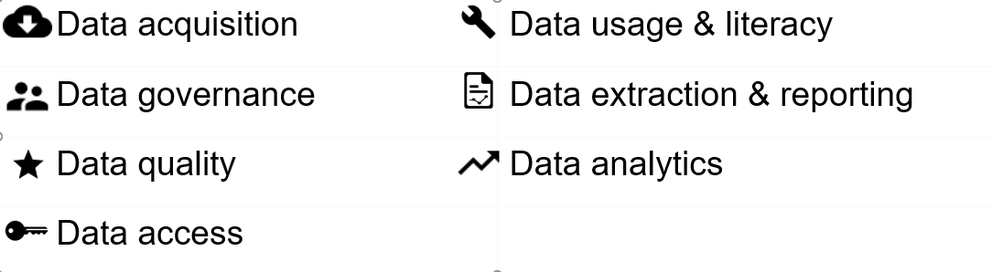
Summary
A data strategy is a larger vision for how your organization will work with data.

